Slide 1
Compiler Design CSE375
Chapter 3
Lexical Analysis
Dr. Shamim H Ripon
CSE, EWU

Slide 2
Outline
Role of lexical analyzer
Specification of tokens
Recognition of tokens
Lexical analyzer generator
Finite automata
Design of lexical analyzer generator

Slide 3
The role of lexical analyzer
token
Source
program
Lexical Analyzer
Parser
To semantic
analysis
getNextToken
Symbol
table

Slide 4
Why to separate Lexical analysis and parsing
Simplicity of design
Improving compiler efficiency
Enhancing compiler portability

Slide 5
Tokens, Patterns and Lexemes
A token is a pair a token name and an optional token value
A pattern is a description of the form that the lexemes of a token may take
A lexeme is a sequence of characters in the source program that matches the pattern for a token

Slide 6
Example
Token
Informal description
Sample lexemes
if
Characters i, f
if
else
Characters e, l, s, e
else
comparison
< or > or <= or >= or == or !=
<=, !=
id
Letter followed by letter and digits
pi, score, D2
number
Any numeric constant
3.14159, 0, 6.02e23
literal
Anything but “ sorrounded by “
“core dumped”
printf(“total = %d\n”, score);

Slide 7
The words generated by the linear analysis may be of different kinds:
identifier,
keyword (if, while, ...),
punctuation character,
multi-character operator (:=, ->, ...).
Such a kind is called a TOKEN and an element of a kind is called a LEXEME.
A word is recognized to be a lexeme for a certain token by PATTERN MATCHING. For instance letter followed by letters and digits is a pattern that matches a word like x or y with the token id (= identifier).

Slide 8
Token | Lexeme | Pattern
ID | x y n0 | letter followed by letters and digits
NUM | -123 1.456e-5 | any numeric constant
IF | if | if
LPAREN | ( | (
LITERAL | ``Hello'' | any string of characters (except ``) between `` and ``

Slide 9
Attributes for tokens
E = M * C ** 2
<id, pointer to symbol table entry for E>
<assign-op>
<id, pointer to symbol table entry for M>
<mult-op>
<id, pointer to symbol table entry for C>
<exp-op>
<number, integer value 2>

Slide 10
Lexical errors
Some errors are out of power of lexical analyzer to recognize:
fi (a == f(x)) …
However it may be able to recognize errors like:
d = 2r
Such errors are recognized when no pattern for tokens matches a character sequence

Slide 11
Error recovery
Panic mode: successive characters are ignored until we reach to a well formed token
Delete one character from the remaining input
Insert a missing character into the remaining input
Replace a character by another character
Transpose two adjacent characters

Slide 12
Input buffering
Sometimes lexical analyzer needs to look ahead some symbols to decide about the token to return
In C language: we need to look after -, = or < to decide what token to return
In Fortran: DO 5 I = 1.25
We need to introduce a two buffer scheme to handle large look-aheads safely
E = M * C * * 2 eof

Slide 13
Sentinels
E = M eof * C * * 2 eof
eof
Switch (*forward++) {
case eof:
if (forward is at end of first buffer) {
reload second buffer;
forward = beginning of second buffer;
}
else if {forward is at end of second buffer) {
reload first buffer;\
forward = beginning of first buffer;
}
else /* eof within a buffer marks the end of input */
terminate lexical analysis;
break;
cases for the other characters;
}

Slide 14
Specification of tokens
In theory of compilation regular expressions are used to formalize the specification of tokens
Regular expressions are means for specifying regular languages
Example:
Letter_(letter_ | digit)*
Each regular expression is a pattern specifying the form of strings

Slide 15
Regular expressions
Ɛ is a regular expression, L(Ɛ) = {Ɛ}
If a is a symbol in ∑then a is a regular expression, L(a) = {a}
(r) | (s) is a regular expression denoting the language L(r) ∪ L(s)
(r)(s) is a regular expression denoting the language L(r)L(s)
(r)* is a regular expression denoting (L9r))*
(r) is a regular expression denting L(r)

Slide 16
Regular definitions
d1 -> r1
d2 -> r2
…
dn -> rn
Example:
letter_ -> A | B | … | Z | a | b | … | Z | _
digit -> 0 | 1 | … | 9
id -> letter_ (letter_ | digit)*

Slide 17
Extensions
One or more instances: (r)+
Zero of one instances: r?
Character classes: [abc]
Example:
letter_ -> [A-Za-z_]
digit -> [0-9]
id -> letter_(letter|digit)*

Slide 18
Recognition of tokens
Starting point is the language grammar to understand the tokens:
stmt -> if expr then stmt
| if expr then stmt else stmt
| Ɛ
expr -> term relop term
| term
term -> id
| number

Slide 19
Recognition of tokens (cont.)
The next step is to formalize the patterns:
digit -> [0-9]
Digits -> digit+
number -> digit(.digits)? (E[+-]? Digit)?
letter -> [A-Za-z_]
id -> letter (letter|digit)*
If -> if
Then -> then
Else -> else
Relop -> < | > | <= | >= | = | <>
We also need to handle whitespaces:
ws -> (blank | tab | newline)+

Slide 20
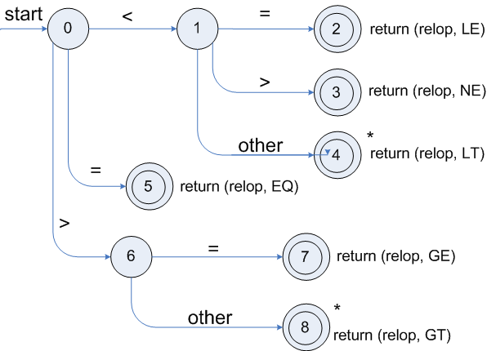
Transition diagrams
Transition diagram for relop

Slide 21
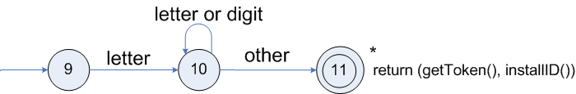
Transition diagrams (cont.)
Transition diagram for reserved words and identifiers

Slide 22
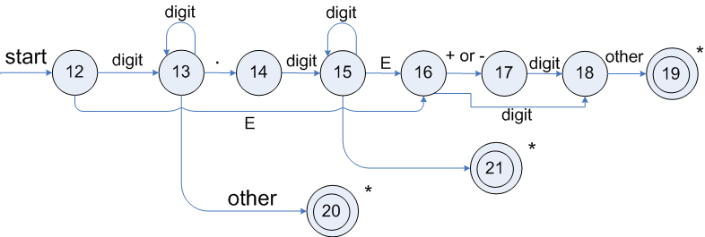
Transition diagrams (cont.)
Transition diagram for unsigned numbers

Slide 23
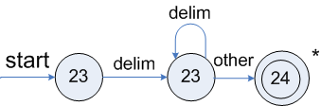
Transition diagrams (cont.)
Transition diagram for whitespace

Slide 24
Architecture of a transition-diagram-based lexical analyzer
TOKEN getRelop()
{
TOKEN retToken = new (RELOP)
while (1) { /* repeat character processing until a
return or failure occurs */
switch(state) {
case 0: c= nextchar();
if (c == ‘<‘) state = 1;
else if (c == ‘=‘) state = 5;
else if (c == ‘>’) state = 6;
else fail(); /* lexeme is not a relop */
break;
case 1: …
…
case 8: retract();
retToken.attribute = GT;
return(retToken);
}

Slide 25
Lexical Analyzer Generator - Lex
Lex Source program
lex.l
Lexical Compiler
lex.yy.c
C
compiler
lex.yy.c
a.out
a.out
Sequence of tokens
Input stream

Slide 26
Structure of Lex programs
declarations
%%
translation rules
%%
auxiliary functions
Pattern {Action}

Slide 27
Example
%{
/* definitions of manifest constants
LT, LE, EQ, NE, GT, GE,
IF, THEN, ELSE, ID, NUMBER, RELOP */
%}
/* regular definitions
delim [ \t\n]
ws {delim}+
letter [A-Za-z]
digit [0-9]
id {letter}({letter}|{digit})*
number {digit}+(\.{digit}+)?(E[+-]?{digit}+)?
%%
{ws} {/* no action and no return */}
if {return(IF);}
then {return(THEN);}
else {return(ELSE);}
{id} {yylval = (int) installID(); return(ID); }
{number} {yylval = (int) installNum(); return(NUMBER);}
…
Int installID() {/* funtion to install the lexeme, whose first character is pointed to by yytext, and whose length is yyleng, into the symbol table and return a pointer thereto */
}
Int installNum() { /* similar to installID, but puts numerical constants into a separate table */
}

Slide 28
Finite Automata
Regular expressions = specification
Finite automata = implementation
A finite automaton consists of
An input alphabet Σ
A set of states S
A start state n
A set of accepting states F ⊆ S
A set of transitions state →^{input} state

Slide 29
Finite Automata
Transition
s₁ →ª s₂
Is read
In state s₁ on input “a” go to state s₂
If end of input
If in accepting state => accept, othewise => reject
If no transition possible => reject

Slide 30
Finite Automata State Graphs
A state
The start state
An accepting state
a
A transition

Slide 31
A Simple Example
A finite automaton that accepts only “1”
A finite automaton accepts a string if we can follow transitions labeled with the characters in the string from the start to some accepting state
1

Slide 32
Another Simple Example
A finite automaton accepting any number of 1’s followed by a single 0
Alphabet: {0,1}
Check that “1110” is accepted but “110…” is not
1
0

Slide 33
And Another Example
Alphabet {0,1}
What language does this recognize?
1
0
0
0
1
1

Slide 34
And Another Example
Alphabet still { 0, 1 }
The operation of the automaton is not completely defined by the input
On input “11” the automaton could be in either state
1
1

Slide 35
Epsilon Moves
Another kind of transition: ε-moves
ε
A
B
Machine can move from state A to state B without reading input

Slide 36
Deterministic and Nondeterministic Automata
Deterministic Finite Automata (DFA)
One transition per input per state
No ε-moves
Nondeterministic Finite Automata (NFA)
Can have multiple transitions for one input in a given state
Can have ε-moves
Finite automata have finite memory
Need only to encode the current state

Slide 37
Execution of Finite Automata
A DFA can take only one path through the state graph
Completely determined by input
NFAs can choose
Whether to make ε-moves
Which of multiple transitions for a single input to take

Slide 38
Acceptance of NFAs
An NFA can get into multiple states
1
0
1
0
Input:
1
0
1
Rule: NFA accepts if it can get in a final state

Slide 39
NFA vs. DFA (1)
NFAs and DFAs recognize the same set of languages (regular languages)
DFAs are easier to implement
There are no choices to consider

Slide 40
NFA vs. DFA (2)
For a given language the NFA can be simpler than the DFA
1
0
0
NFA
0
1
0
0
0
DFA
1
1
DFA can be exponentially larger than NFA

Slide 41
Regular Expressions to Finite Automata
High-level sketch
NFA
Regular
expressions
DFA
Lexical
Specification
Table-driven
Implementation of DFA

Slide 42
Regular Expressions to NFA (1)
For each kind of rexp, define an NFA
Notation: NFA for rexp A
A
For ε
ε
For input a
a

Slide 43
Regular Expressions to NFA (2)
For AB
ε
A
B
For A | B
B
ε
ε
ε
ε
A

Slide 44
Regular Expressions to NFA (3)
For A*
ε
A
ε
ε

Slide 45
Example of RegExp -> NFA conversion
Consider the regular expression
(1 | 0)*1
The NFA is
ε
1
ε
ε
C
E
A
B
1
ε
0
G
H
ε
I
J
ε
D
F
ε
ε

Slide 46
Next
NFA
Regular
expressions
DFA
Lexical
Specification
Table-driven
Implementation of DFA

Slide 47
NFA to DFA. The Trick
Simulate the NFA
Each state of resulting DFA
= a non-empty subset of states of the NFA
Start state
= the set of NFA states reachable through ε-moves from NFA start state
Add a transition S →ª S’ to DFA iff
S’ is the set of NFA states reachable from the states in S after seeing the input a
considering ε-moves as well

Slide 48
NFA -> DFA Example
ε
1
ε
ε
C
E
A
B
1
ε
0
G
H
ε
I
J
ε
D
F
ε
ε
0
0
FGABCDHI
0
1
ABCDHI
1
1
EJGABCDHI

Slide 49
NFA to DFA. Remark
An NFA may be in many states at any time
How many different states ?
If there are N states, the NFA must be in some subset of those N states
How many non-empty subsets are there?
2^{N} - 1 = finitely many, but exponentially many

Slide 50
Implementation
A DFA can be implemented by a 2D table T
One dimension is “states”
Other dimension is “input symbols”
For every transition S_{i} →ª S_{k} define T[i,a] = k
DFA “execution”
If in state S_{i} and input a, read T[i,a] = k and skip to state S_{k}
Very efficient

Slide 51
Table Implementation of a DFA
0
0
T
0
1
S
1
1
U
 | 0 | 1
S | T | U
T | T | U
U | T | U

Slide 52
Implementation (Cont.)
NFA -> DFA conversion is at the heart of tools such as flex or jflex
But, DFAs can be huge
In practice, flex-like tools trade off speed for space in the choice of NFA and DFA representations

Slide 53
Readings
Chapter 3 of the book

